Slide 1
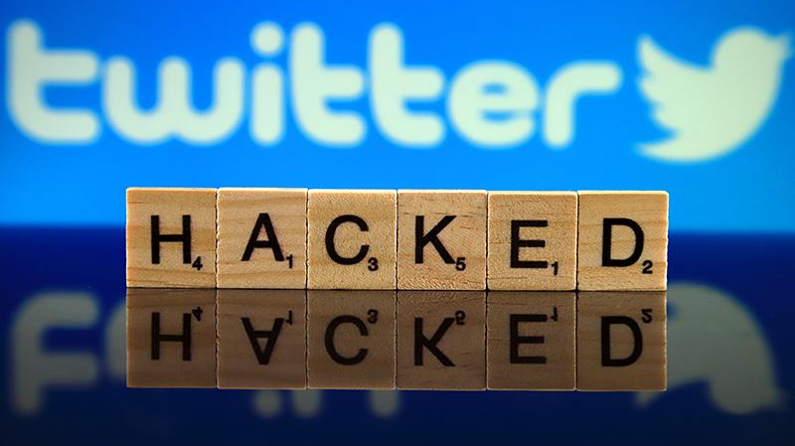
(IS 401/501-01 MERGED) (FA23) CYBERSECURITY PRINCIPLES FINAL PROJECT – TWITTER HACK 2020
By:
Amogh Patel
11/30/2023

Slide 2
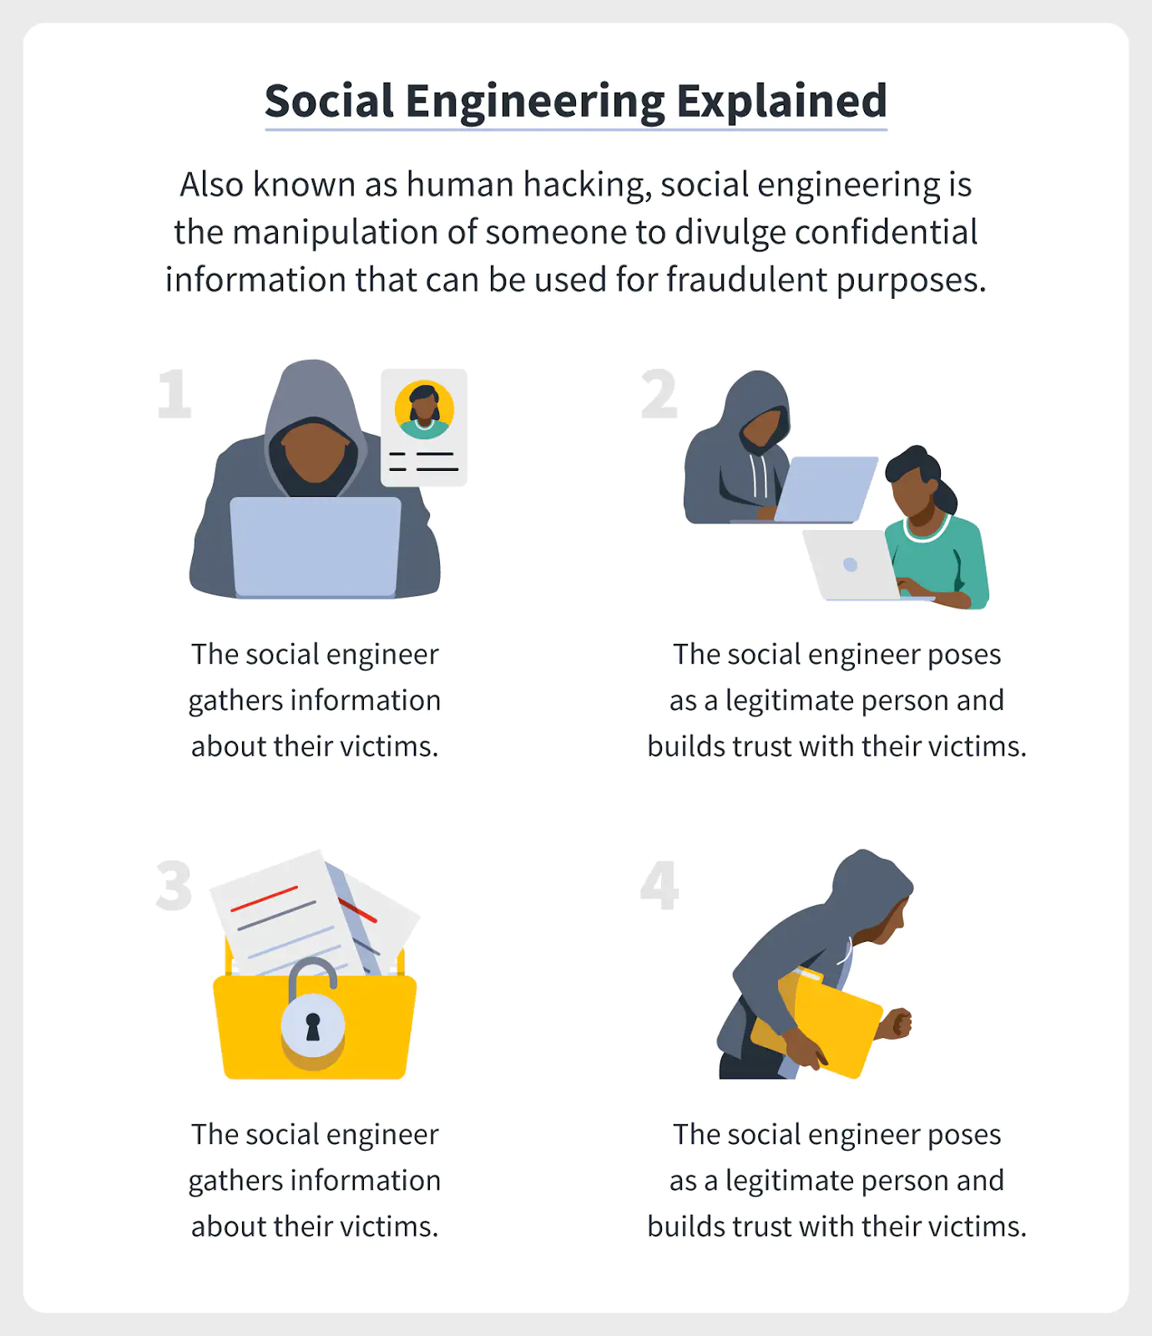
Introduction
What do we imagine when we hear about a cybersecurity breach?
Twitter 2020 hack did not involve any of the high-tech or sophisticated techniques.
Social Engineering.
Impact: Twitter Hack exposed the potential for widespread manipulation and interference through social media platforms, raising concerns about the integrity of elections, financial markets, and national security.

Slide 3

Company Affected
The Twitter Hack, occurring on July 15, 2020, targeted Twitter, a publicly traded technology company valued at the time at $37 billion. The hackers compromised 130 Twitter accounts, including those of high-profile individuals, politicians, celebrities, business personals and cryptocurrency companies.

Slide 4
What Happened?
The breach occurred on July 15th 2020.
Executed by a 17-year-old hacker and accomplices.
The breach exposed critical weakness in Twitter’s cybersecurity infrastructure.
Perpetrators seized control of high-profile accounts belonging to highly influential people.
Social engineering tactics used, posing as Twitter IT personnel to deceive employees to divulge crucial company security information.
First Phase: Used the admin access to sell OG Twitter usernames.
Second Phase: Accessed directs messages of the compromised accounts. Downloaded 8 accounts data.
Third Phase: Using the access to the high-profile accounts executed a cryptocurrency scam (Impact: $118,000).

Slide 5
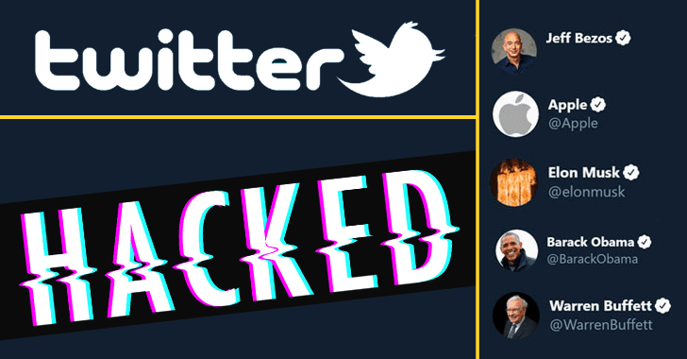
Weaknesses and Vulnerabilities
Lack of Chief Information Security Officer.
Weak leadership and senior-level engagement.
Transition to remote work and VPN issues.
Social engineering (vishing) tactics.
Insufficient employee training.
Delayed implementation of security controls.

Slide 6
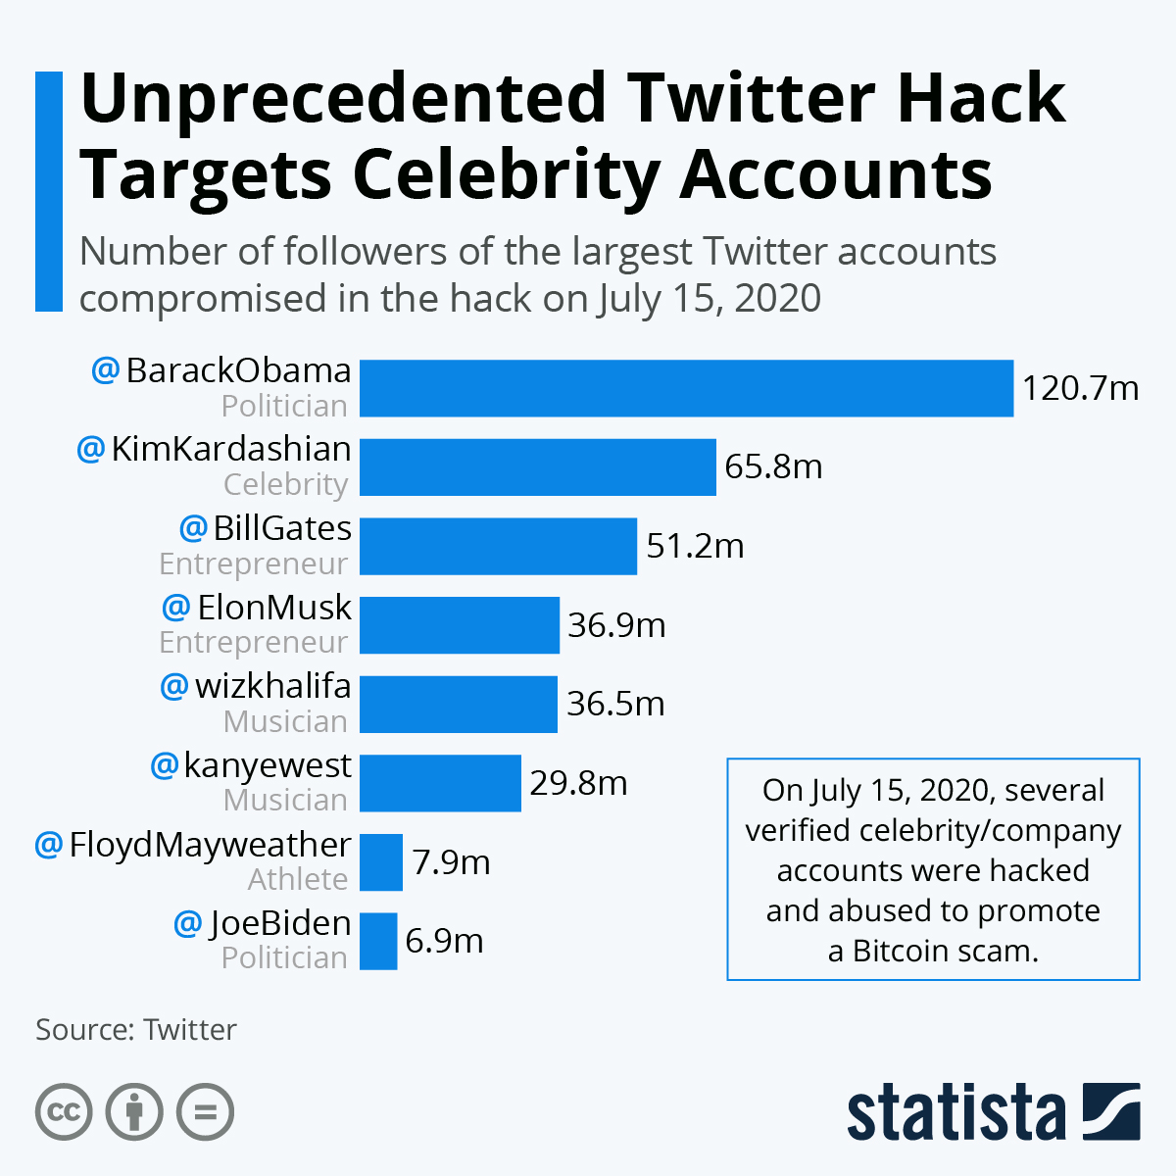
Impact on the Organization
Reputation damage.
Operational disruption.
Financial costs.
Data breach consequences.
Response and recovery efforts.

Slide 7

Threat Actors and Motivations
Young individuals involved in the attack.
Limited realization of the power they had.
Financial motivations behind the attack.

Slide 8
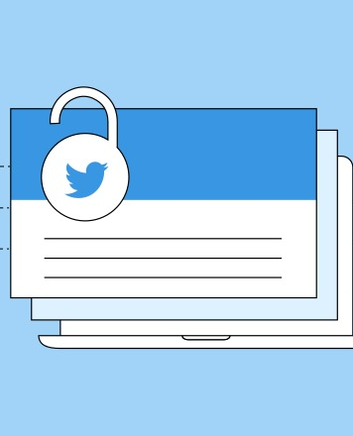
Recommendations
Employee training and awareness.
Access control and principle of least privilege.
Security audits and assessments.
Incident response plan.
Monitoring and logging.
Communication protocols.
Backup and recovery.
Collaboration with security experts.

Slide 9
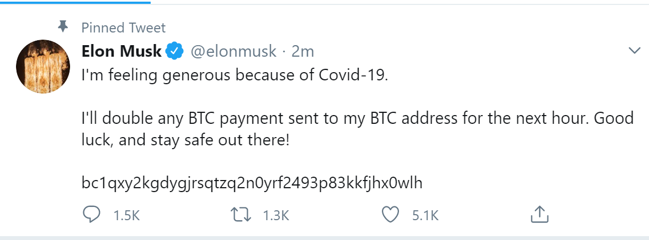
Conclusion
This hack is the perfect example that illustrates users are the weakest link in the security chain.
We live in an interconnected world.
Awareness and education on social engineering techniques.
Key Takeaways: Beyond financial losses, the incident highlights the potential for significant harm to public trust, elections, and global stability.

Slide 10
References for images and art used:
https://terranovasecurity.com/what-is-social-engineering/
https://cybersecuritynews.com/twitter-hacked-2/
https://www.statista.com/chart/22296/accounts-compromised-in-twitter-cyber-attack/
https://sproutsocial.com/insights/hacked-twitter-account/
https://www.vectorstock.com/royalty-free-vectors/black-hat-hacker-icon-vectors
https://cointelegraph.com/news/crypto-twitter-hack-recap-a-wake-up-call-for-centralized-platforms

